Slide 1


Closing Achievement
Gaps:
Leshaun Jenkins
JPLA
12//12/19
Amongst African-American Males In Intro to Math 1

Slide 2

The context of my Problem of Practice (PoP) revolves around identifying the causes of achievement gaps that have existed amongst minority males, particularly in the area of Intro to Math (Math I) at Tarboro High School. Historically across the board, minority males have performed significantly lower than other subgroups, not only in Math , but also in other core subjects.

Slide 3
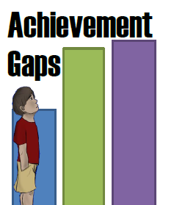
The Problem:
Deep Data Dive Reveals Achievement Gaps
Classroom Observations were very telling that there was a problem.
One on One student Interviews revealed problems that existed within the pedagogical structuring of the class.
Benchmark data was very revealing of prior assumptions made about the problems of practice.

Slide 5
A Look at Data
Subgroups | Benchmark Data
African American Males | 23.8%
African American Females | 34.2%
White Males | 44.5%
White Females | 29%
Hispanic Males | ----------
Hispanic Females | ------------
Based on Benchmark Data, there is a 5%-21% achievement gap amongst African-American males and other subgroups.

Slide 6

Data Comparisons
African-American Males Benchmark Data | All Other Subgroups Benchmark Data
23.85% | 35.91%

Slide 7
Data Comparisons
African American Males | White Males
23.85% | 44.5%

Slide 8
Data Comparisons
African-American Males | African-American Females
23.85% | 34.25%

Slide 9
Data Comparisons
African-American Males | White Females
23.85% | 29%

Slide 10
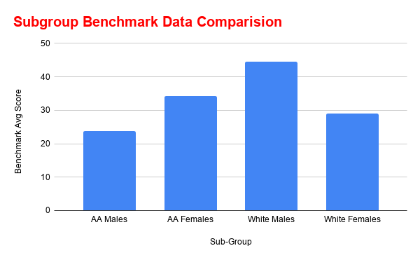
“The Narrative”

Slide 11
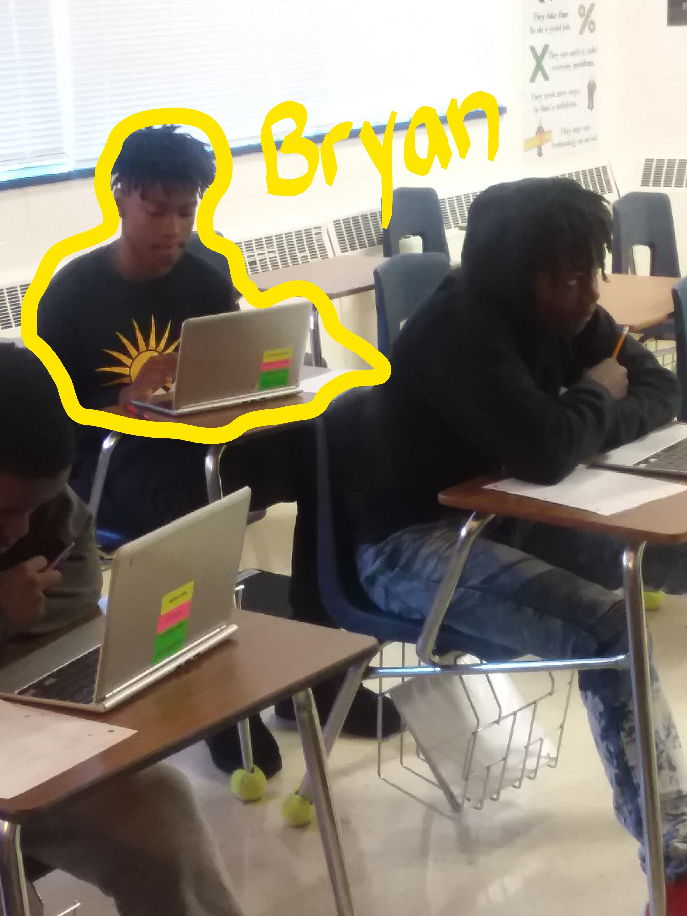
Bryan Mitchell
Day in The Life Shadowing
Classification: Freshman
Intro to Math 1 Mock Score: 24%
Intro to Math 1 Benchmark Score: 14%

Slide 12

Assumptions
I believe the interventions that I have proposed will have a direct implication on instruction, student engagement, and student choice and voice. Ultimately I believe interventions will impact student achievement, especially amongst minority males.

Slide 13
More Assumptions
I believe that the proposed intervention will work based on qualitative data collected during observation and student interviews;
Student in student interview spoke about not understanding why he will need it in the future.
One student spoke about being bored; would like to learn Math through a lens that he can relate to.
Students spoke of wanting to collaborate more in groups/learning teams. The only day that I observed students being asked to turn and talk, the energy and engagement level was amazingly higher than any other time.

Slide 14
Resources
In Departmental PLCs, teachers will look directly at achievement gaps weekly during their Data PLC. In this data dive, teachers will be able to identify students (minority males) who are lagging significantly behind other students. Teachers will design/prescribe proper interventions based on the data.
Resources include Intro to Math 1 Teachers, Math I Teachers, MCL for Math; Instructional Leaders, EC Teachers and Students. The curriculum that will be used will be the Math 1 Curriculum in addition to Unpacking Documents, Cross Walk Documents, and NCDPI released items, and Test Spec documents.

Slide 15
Activities/
Interventions
Weekly Data PLCs; evaluation of holistic data as well as individual student data to identify the multitude of the achievement gap, if one exist. Being intentional is key.
Weekly Planning PLCs: Planning should be done around the data outcomes;
PD centered around student achievement
Increase in student agency, voice, and choice
Focus of collaboration and collaborative learning opportunities

Slide 16
Why These Interventions?
I selected these interventions because achievement gaps sometimes exists because of inequitable practices. With a focus on data driven instruction, with the intentionality lesson planning , I do believe that not only will gaps be identified, but I believe these achievement gaps will be marginalized as well.
The intentionally of the teacher & instructional leader, I feel strongly that there will be an increase in student performance, proficiency, and growth.

Slide 17
Desired Outputs
Effective and intentional PLC schedules (Math Department).
Student Data Tracking forms/systems (holistic and individual data)
Tracking document/sheet that populates student results/achievement gaps.

Slide 18
Desired Outcomes
An increase in overall holistic student performance across the board.
An increase in individualized student performance.

Slide 19
Desired Impact
The desired impact is to:
Improve the quality of delivered instruction
Be intentional about disaggregating data, that could and should reveal achievement gaps
Integrate culturally aligned relevant Math instruction
Integrate collaborative learning opportunities
Increase student engagement through increased student agency, student voice, and student choice.
To see a significant decrease in the overall achievement gaps that exist amongst black males in the area of Into to Math I.

Slide 20
Evaluation Questions
Research Questions?
How will I obtain data? | The data will be obtained through school based, district, and state mandated testing.
Pre & Post Measures? | Classroom Formative Assessments
Quantitative /Qualitative Methods to evaluate Your project | Quantitative Data (Mock scores, Benchmark scores, CFA scores, Classroom assessments, and EOC/NCFE Data.

Slide 21

Thank You!
Leshaun T. Jenkins

