Slide 1
PLC & instructional Design
Ths staff Meeting
January 6, 2020

Slide 2
Weekly Instructional Strategies Phase I
Components of a Mini-Lecture
Instructional Differentiation
Meaningful Lesson Hooks
Vocabulary Immersion
Quality Essential Questions

Slide 3
Deep Data Dive
FALL SEMESTER

Slide 4
Phase II of instructional development
Depth of Knowledge
Rigor
21st Century Skill Immersion
Blooms Taxonomy/Learning Systems
Intentional Coaching

Slide 5
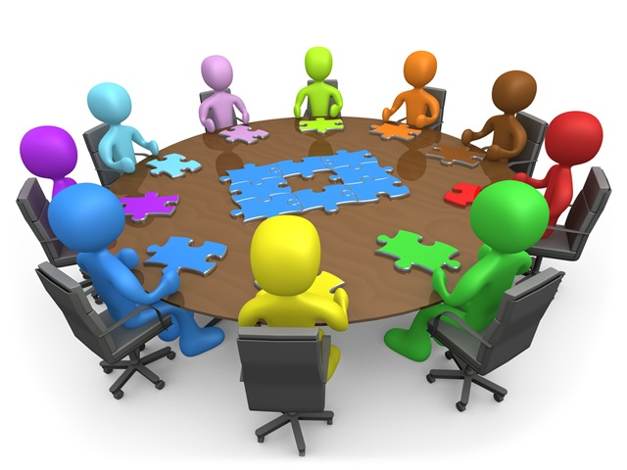
Plc progression and development
Data PLc
Planning plc
Collection of aligned data
Disaggregation of data
Identification of misconceptions/missed opportunities
Reteaching/Data Driven Instruction
Collaboration
Data Driven Instruction
Quality Instruction following Instructional focus

Slide 6
THS System
Quality PLCs
+
+Quality Instruction
=
Great Data Outcomes

Slide 7
Deep data dive
SPRING sEMESTER

Slide 8
WEEK OF JANUARY 20TH DEPARTMENTAL PLC ACTIVITY WILL RESUME!

