Slide 1
Staff Meet and Greet
Tarboro High
School of Purpose, Promise, & Pride

Slide 2
Instructions
Add a slide that includes your name, a picture of you or your family; images that represent some things about you and some things that are symbolic of your WHY. Be prepared to stand and deliver in 30 seconds or less!
Click on Insert and scroll down to new slide and begin your slide design!

Slide 3
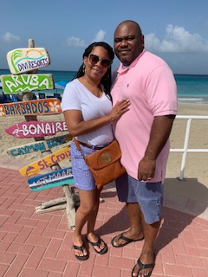
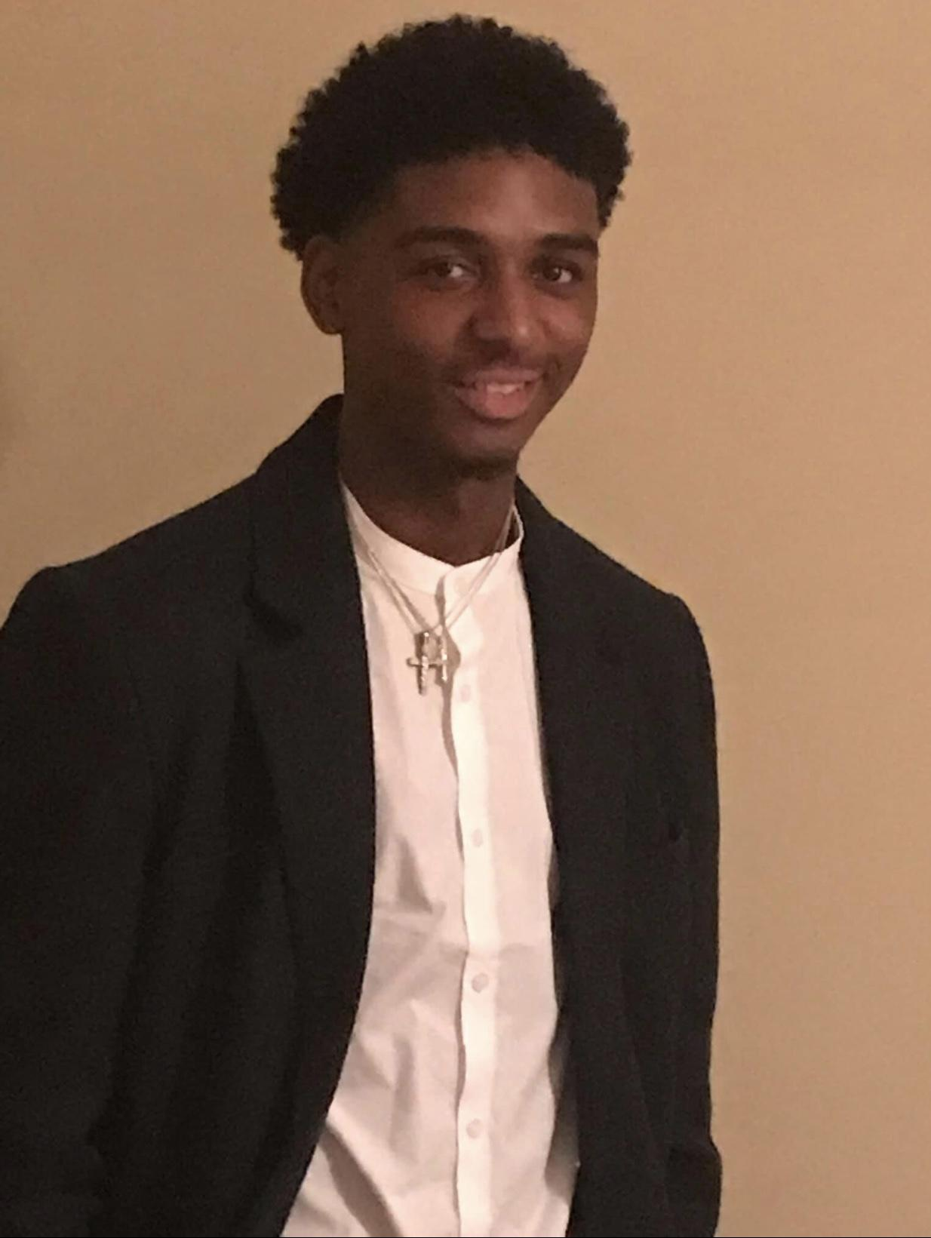
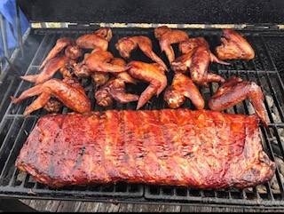
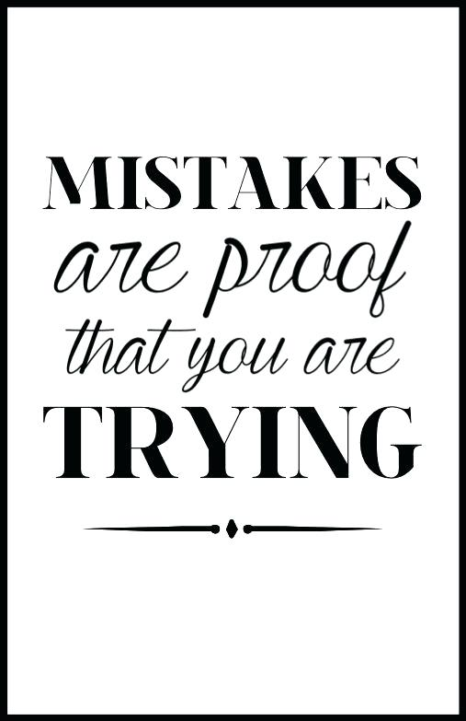
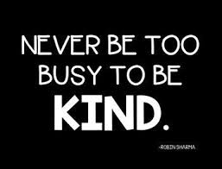
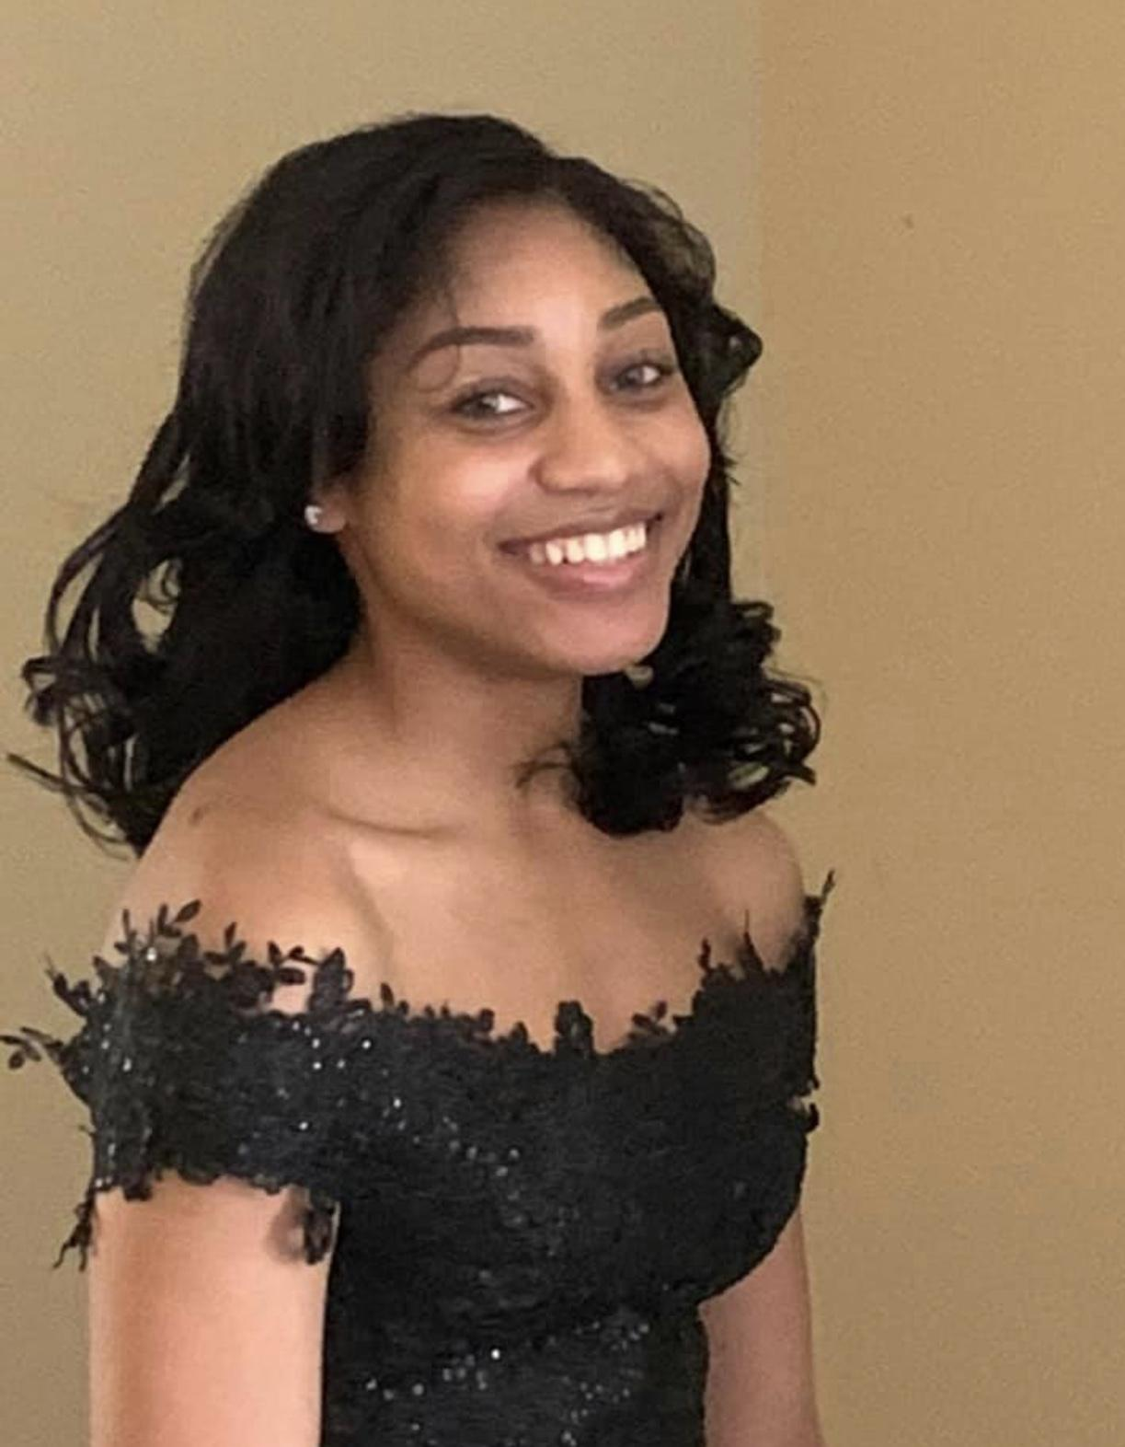
Terry Hopkins-Principal
https://thumbs.gfycat.com/AppropriateSpanishAbalone.webp

Slide 4
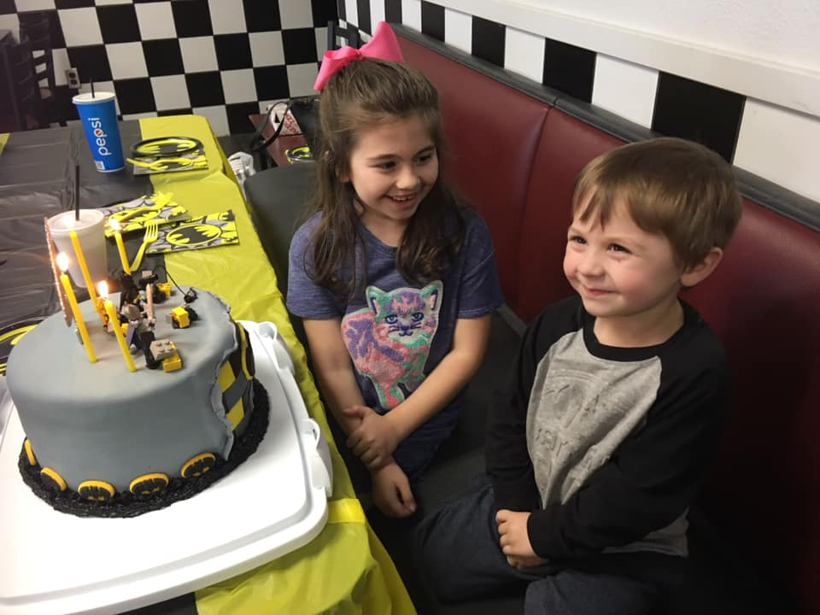
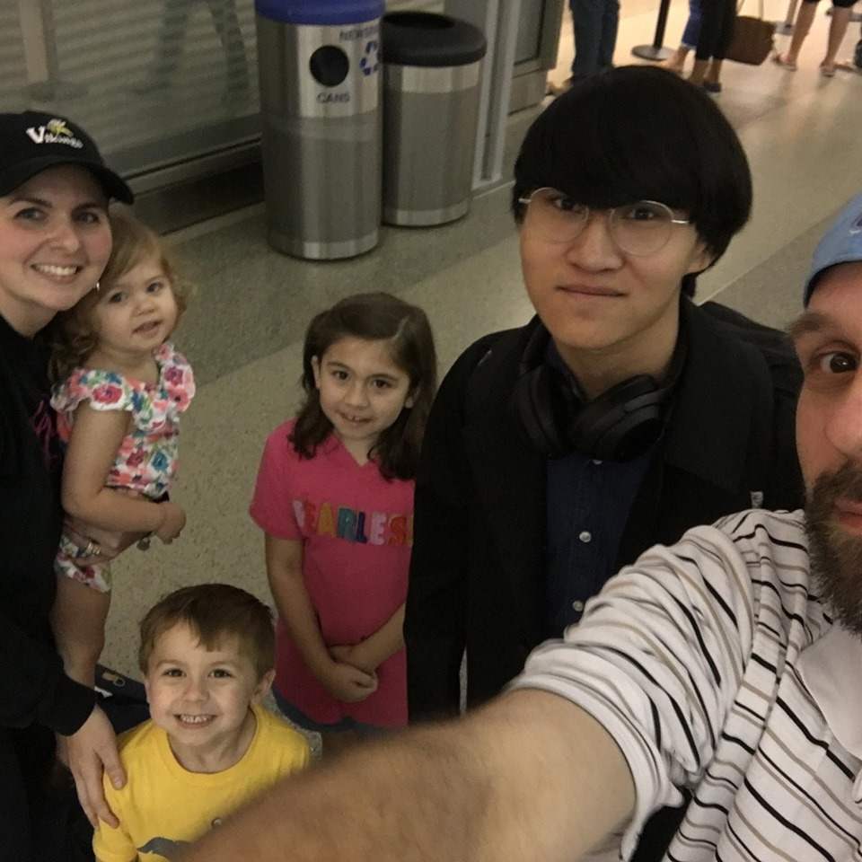
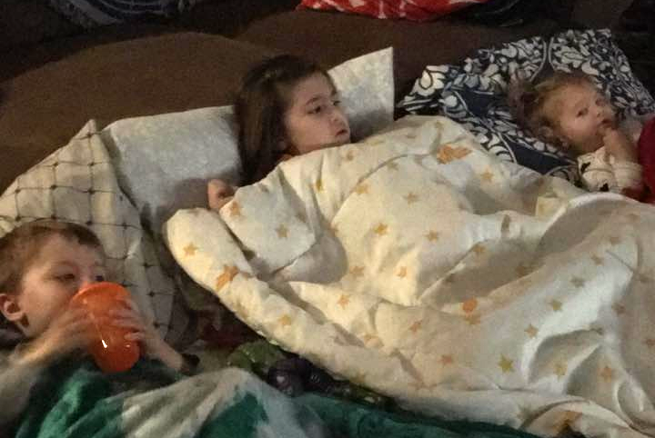
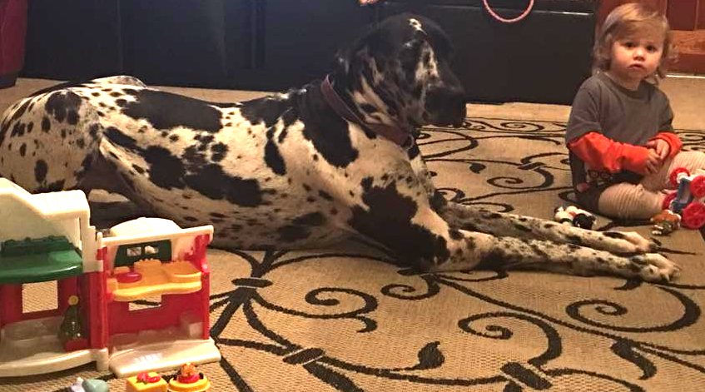
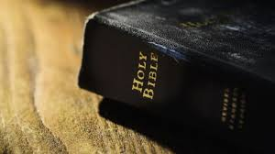
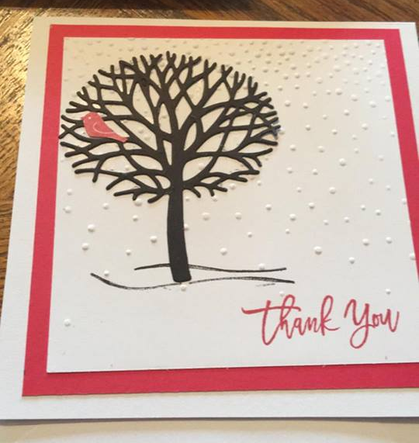
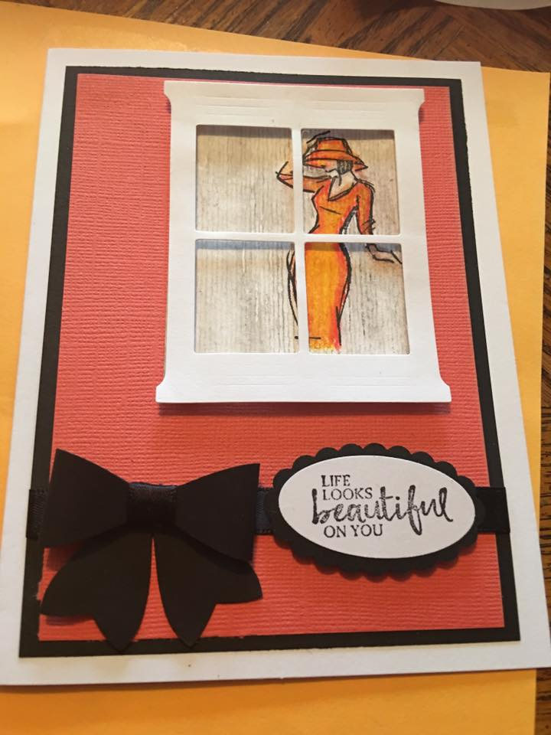
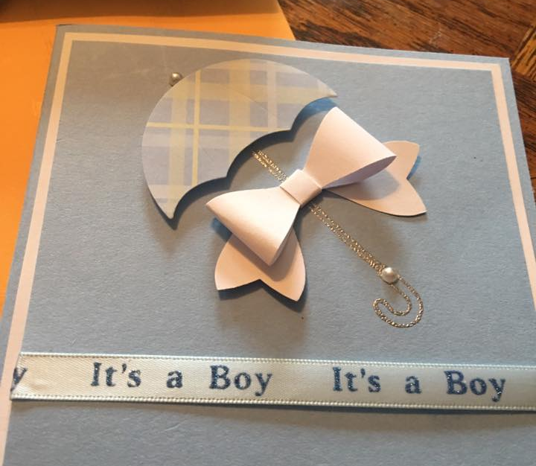
ᆞHillary Boutwell - Assistant Principalᆞ

Slide 5
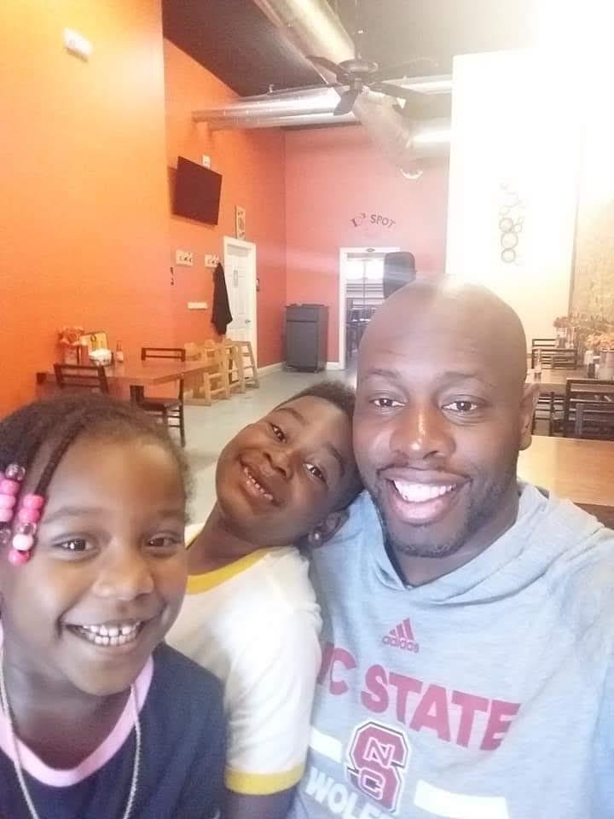
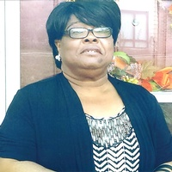
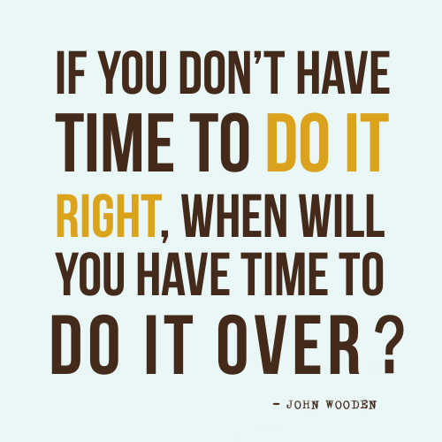
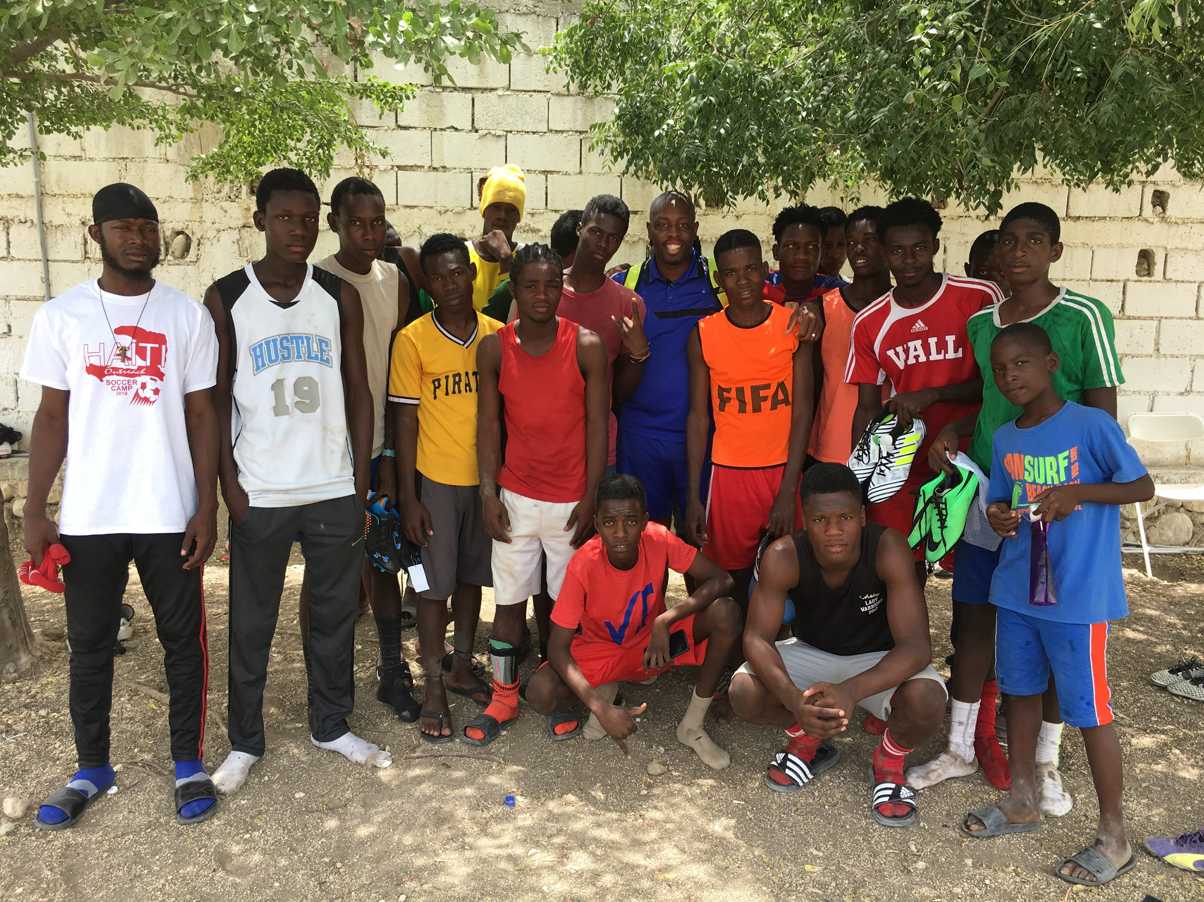
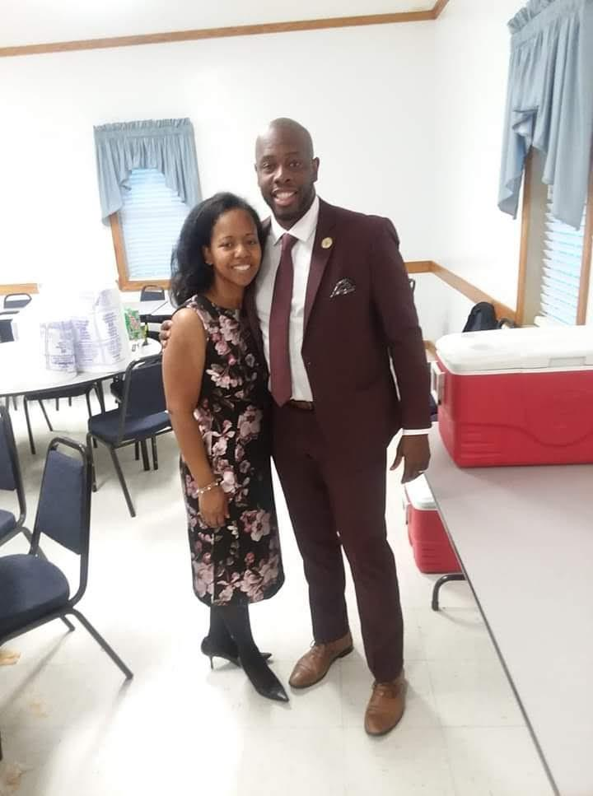
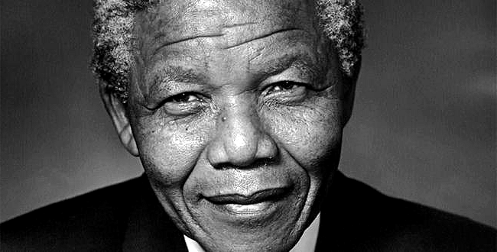
Leshaun Jenkins-Assistant Principal
Notes:
My name is Leshaun T. Jenkins. I am entering my 19th year in the educational field. All 19 years have been with ECPS. My first 16 years I served at a History Teacher here at THS. I spent one year in a split AP role at Phillips Middle and Princeville Elementary. Year #18 I spent as an AP at Princeville soley. I am extremely grateful to return to THS and am excited to be a servant leader as part of the great Administrative Team.
I attended East Carolina for undergrad and am finishing the NELA Principals Academy currently at NC State.
Nelson Mandela (to me) is one of the greatest humans this world has ever seen. His life inspires me. His tenacity and resilience to not give up on such a dark world. He proves to me that anything is possible through faith. From prison to president!
My great neice and my great nephew keep me energized and inspired. I want them to live in a world that does not marginalize them, but empowers them to be the best version of themselves.
My wife Anchelle is a dream come true. She is everything I need in a wife plus more. She is truly the calm to my storm...literally!
My kids in Haiti remind me to just be grateful for what I have and for the gifts that GOD has planted in me. Having recently returned from Haiti for the 8th time, I am inspired more than ever to be an agent of change in this world.
I love my fraternity that was founded in 1906. My why is deeply connected to our AIMS: Mainly Deeds, Scholarships, and Love for all Mankind
My new favorite book: Miracle on Voodoo Mountain-the story of an American Missionary who finds her calling to serve the children in Haiti
Quote: I love this quote because if I am going to do anything I want to do it with fidelity and will my all the FIRST TIME!
My mom passed away on 10.27.18 at 9:33am. She was and is my world! Almost 9 months later I still struggle to navigate through life without her. Warning: I still grieve. I don’t try to hide it when it happens, I just allow it to take its course. Keep me in your prayers.

